Slide 1
CLOUD PROJECT
Team Details
Team Name:
TEAM MEMBERS:
Alice - 3124XXXXXXXX DEPT COLLEGE
BOB - 3124XXXXXXXX DEPT COLLEGE
PROBLEM Statement title: Automated attendance system (e.g.)

Slide 2
INTRODUCTION AND ABSTRACT
INTRODUCTION:
Describe your problem statement
ABSTRACT:
Give a description of how you are going to solve the problem

Slide 3
Proposed solution
Detailed technical explanation of your solution

Slide 4
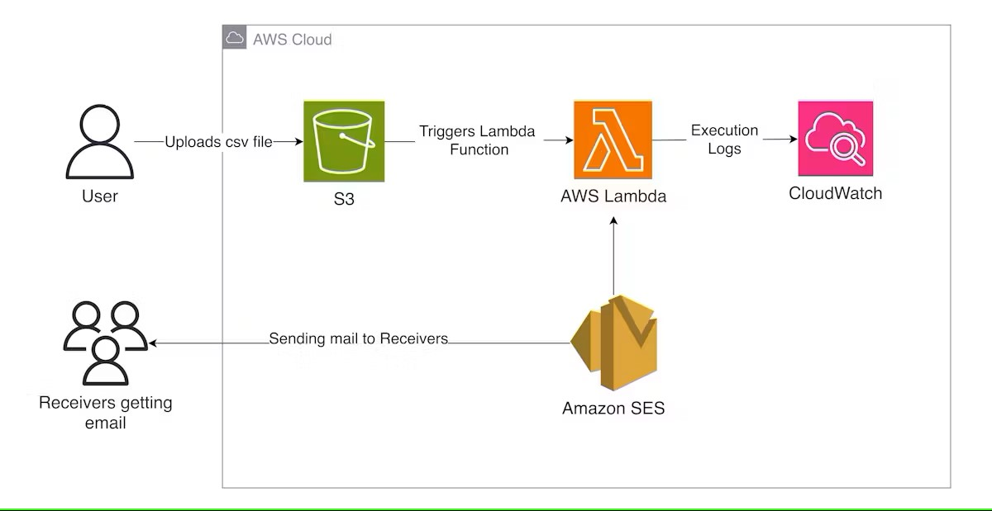
Architecture DIAGRAM AND TECH STACK
GIVE TECH STACK OR ARCHITECTURE DESCRIPTION HERE

Slide 5
USE CASES:
DEPENDENCIES:
Give use case diagram, or description
Give Dependencies involved in your project

Slide 6
FUTURE WORK AND CONCLUSION
FUTURE WORK
CONCLUSION

